Slide 1
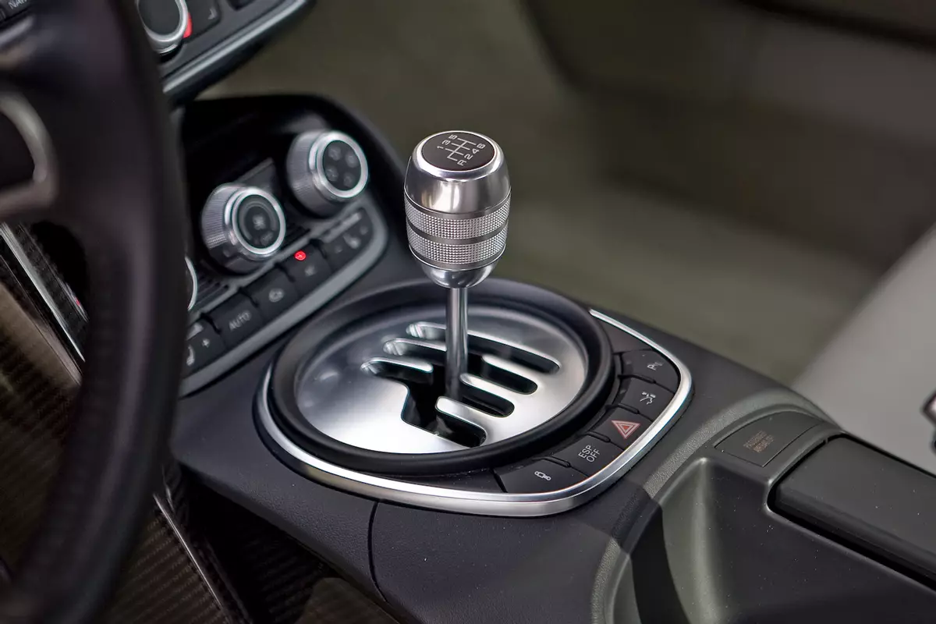
Data101 Students and Stick-shift cars.
Assignment 9 by Arnav Dashaputra

Slide 2
I will try to figure out what prior information about a random Data101 student will help me decide whether or not they are able to drive a stick-shift car.
Scenario: I am renting a car for them, and I am not sure if they prefer stick shift cars or not. While stick shift cars are cheaper rentals, they require more skill to drive.

Slide 3
Prior: what is the probability of a data101 student can drive a stick shift car?
First, I imported and installed the packages stringr and dplyr to find the string “Stick Shift” in all rows of the V9 column. This is self explanatory, so I did not include the import statements here. I also renamed the data table, but did not rename the columns as it was easier for me to work with the data in this manner.
> survey = F21DataSurveyWithSectionsAnonymized > options(max.print=999999)
> survey %>% //pipes to survey df
+ filter(str_detect(survey$V9, "stick"))
This returned all the rows, and using the index of the last row, it can be seen that that 43 could drive stick shift, while the remaining 204 could not.
This means that without any other information, there is a 17.41% chance that a random student can drive stick, and a 82.59% chance they can not.
P(Can Use Stick) = 43/247 = 0.1741
P(Can’t Use Stick) = 0.8259.

Slide 4
What if I know the random student can use a rotary phone?
> survey %>% //pipes to survey df
+ filter(str_detect(survey$V8, "Yes, and I have"))
P(Has used rotary phone) = 40/247 = 0.1619 + filter(str_detect(survey$V8, "Yes, and I have") & str_detect(survey$V9, "stick"))
P(Used Rotary | Can Drive Stick) = 13/43 = 0.3023
+ filter(str_detect(survey$V8, "Yes, and I have") & !str_detect(survey$V9, "stick"))
P(Used Rotary | Can’t Drive Stick) = 27/204 = 0.1324
P(Can Drive Stick | Used Rotary) = P(Used Rotary | Can Drive Stick) * P(Can Drive Stick) / P(Used Rotary)
= 0.3023 * 0.1741 / 0.1619 = 0.3251
P(Can’t Drive Stick | Used Rotary) = P(Used Rotary | Can’t drive Stick) * P(Can’t Drive Stick) / P(Used Rotary)
= 0.1324 * 0.8259 / 0.1619 = 0.6754
Support P(Can Drive Stick | Used Rotary) = Percentage that have both driven stick and used rotary = 13/247 = 0.05263
Support P(Can’t Drive Stick | Used Rotary) = Percentage that have can not drive stick but can use rotary = 27/247 = 0.1093
If I know they have used a rotary phone, they are more likely (67.5%) to not be able to drive stick.

Slide 5
What if I know the random student like setting cooler temps?
> table(survey$V10)
P(Cooler) = 144/247 = 0.58299
> survey %>% + filter(str_detect(survey$V10, "Cooler") & str_detect(survey$V9, "stick"))
P(Cooler | Can Drive Stick) = 26/43 = 0.6047
+ filter(str_detect(survey$V10, "Cooler") & !str_detect(survey$V9, "stick"))
P(Cooler | Can’t Drive Stick) = 118/204 = 0.5784 P(Can Drive Stick | Cooler) = P(Cooler | Can Drive Stick) * P(Can Drive Stick) / P(Cooler)
= 0.6047 * 0.1741 / 0.58299 = 0.18058
P(Can’t Drive Stick | Cooler) = P(Cooler | Can’t drive Stick) * P(Can’t Drive Stick) / P(Cooler)
= 0.5784 * 0.8259 / 0.58299 = 0.81939
Support P(Can Drive Stick | Cooler) = Percentage that have driven stick and prefer cooler temps = 26/247 = 0.1053
Support P(Can’t Drive Stick | Cooler) = Percentage that have can not drive stick but prefer cooler temps = 118/247 = 0.478
If I know they have to set cooler thermostats, they are more likely (81.9%) to not be able to drive stick.

Slide 6
What if I know the random student uses an Android?
> table(survey$V10)
P(Android) = 53/247 = 0.2146
> survey %>% + filter(str_detect(survey$V14, "Android") & str_detect(survey$V9, "stick"))
P(Android | Can Drive Stick) = 11/43 = 0.2558
+ filter(str_detect(survey$V14, "Android") & !str_detect(survey$V9, "stick"))
P(Android | Can’t Drive Stick) = 42/204 = 0.2059 P(Can Drive Stick | Android) = P(Android| Can Drive Stick) * P(Can Drive Stick) / P(Android)
= 0.2558 * 0.1741 / 0.2146 = 0.2075
P(Can’t Drive Stick | Android) = P(Android | Can’t drive Stick) * P(Can’t Drive Stick) / P(Android)
= 0.2059 * 0.8259 / 0.2146 = 0.7924
Support P(Can Drive Stick | Android) = Percentage that have driven stick and prefer Android = 11/247 = 0.0445
Support P(Can’t Drive Stick | Android) = Percentage that have can not drive stick but prefer Android = 42/247 = 0.17
If I know they prefer Android, they are more likely (79.2%) to not be able to drive stick.

Slide 7
How can I use this information
Based on the information I already know about a random Data101 student that I select, I can figure out if they are more likely to have the ability to drive stick shift cars.
Without prior information, I can assume that the student does not know how to drive stick shift (82.5%) and so I should bring an automatic car.
No matter if I know the student can use a rotary phone (67.5%), prefers colder temperatures (81.9%), or uses an Android (79.2%), they will still most likely want to drive an automatic car.

